Slide 1
Single-Layer Perceptrons (PART 2)

Slide 2
Chapter Organization
Linear Adaptive Filters and LMS algorithm
Adaptive Filtering Problem
Unconstrained Optimization Techniques
Method of Steepest Descent
Newton’s Method
Gauss-Newton Method
Linear Least Squares Filter
LMS Algorithm
Learning Curves
Learning-Rate Annealing Schedules (mostly omitted)
Rosenblatt’s Perceptron
Perceptron
Perceptron Convergence Theorem
Relation between Perceptron and Bayes Classifier for a Gaussian Environment (omitted)

Slide 3
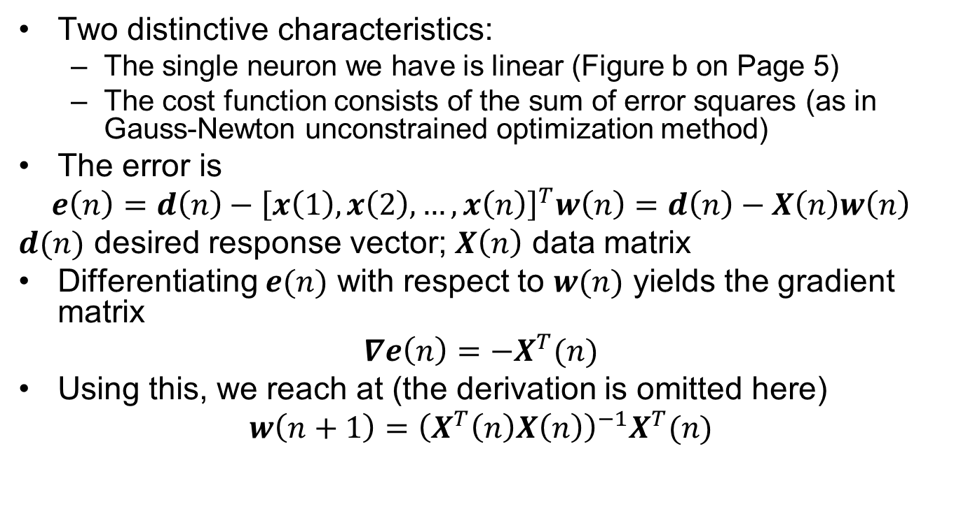
Linear Least-Squares Filter
Two distinctive characteristics:
The single neuron we have is linear (Figure b on Page 5)
The cost function consists of the sum of error squares (as in Gauss-Newton unconstrained optimization method)
The error is
$$e\left(n\right)=d\left(n\right)−{\left[x\left(1\right),x\left(2\right),…,x\left(n\right)\right]}^{T}w\left(n\right)=d\left(n\right)−X\left(n\right)w\left(n\right)$$
$d(n)$ desired response vector; $X\left(n\right)$ data matrix
Differentiating $e(n)$ with respect to $w(n)$ yields the gradient matrix
$$∇e\left(n\right)=−X^{T}(n)$$
Using this, we reach at (the derivation is omitted here)
$$w\left(n+1\right)={\left(X^{T}\left(n\right)X\left(n\right)\right)}^{−1}X^{T}(n)$$

Slide 4
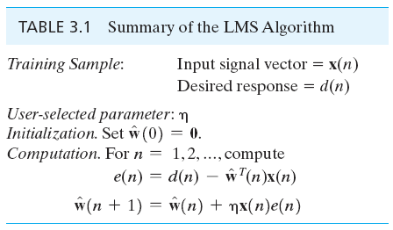
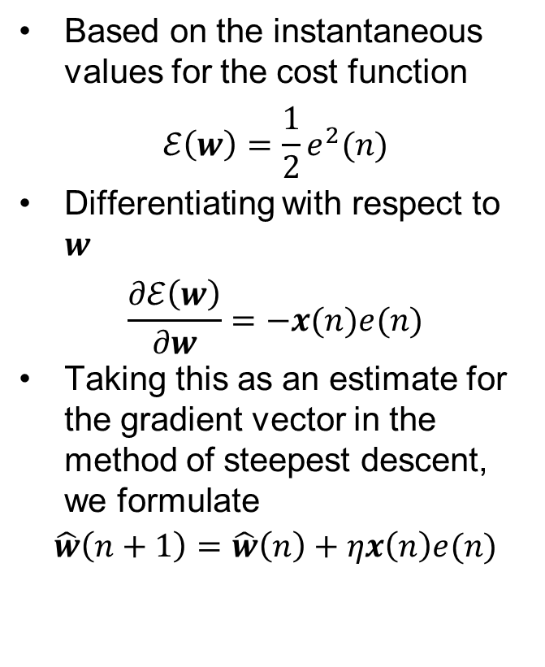
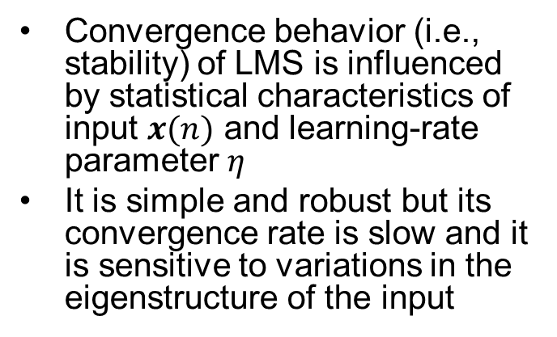
Least-Mean-Square (LMS) Algorithm
Based on the instantaneous values for the cost function
$$ℰ\left(w\right)=\frac{1}{2}e^{2}(n)$$
Differentiating with respect to $w$
$$\frac{∂ℰ\left(w\right)}{∂w}=−x(n)e(n)$$
Taking this as an estimate for the gradient vector in the method of steepest descent, we formulate
$$\hat{w}\left(n+1\right)=\hat{w}\left(n\right)+ηx\left(n\right)e(n)$$
Convergence behavior (i.e., stability) of LMS is influenced by statistical characteristics of input $x(n)$ and learning-rate parameter $η$
It is simple and robust but its convergence rate is slow and it is sensitive to variations in the eigenstructure of the input

Slide 5
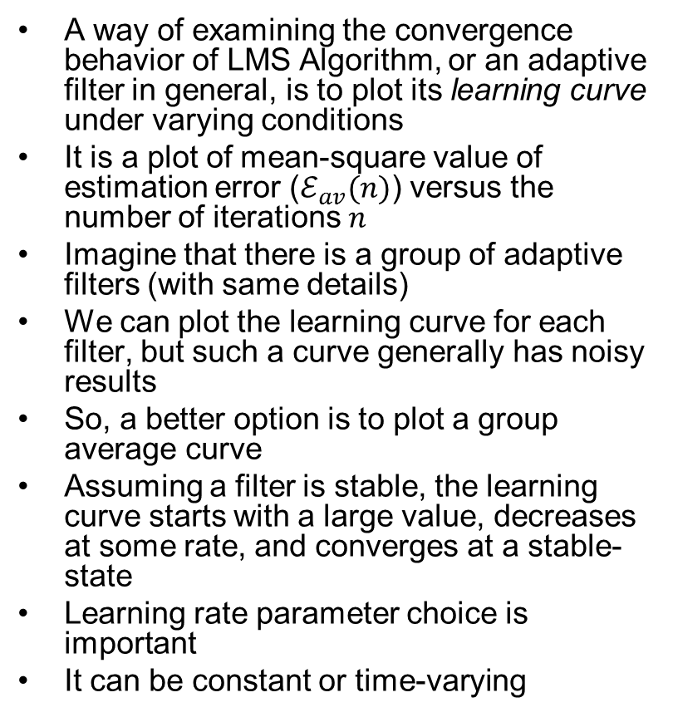
Learning Curves
A way of examining the convergence behavior of LMS Algorithm, or an adaptive filter in general, is to plot its learning curve under varying conditions
It is a plot of mean-square value of estimation error ($ℰ_{av}(n)$) versus the number of iterations $n$
Imagine that there is a group of adaptive filters (with same details)
We can plot the learning curve for each filter, but such a curve generally has noisy results
So, a better option is to plot a group average curve
Assuming a filter is stable, the learning curve starts with a large value, decreases at some rate, and converges at a stable-state
Learning rate parameter choice is important
It can be constant or time-varying
Squared Error
Iterations

Slide 6
Chapter Organization
Linear Adaptive Filters and LMS algorithm
Adaptive Filtering Problem
Unconstrained Optimization Techniques
Method of Steepest Descent
Newton’s Method
Gauss-Newton Method
Linear Least Squares Filter
LMS Algorithm
Learning Curves
Learning-Rate Annealing Schedules (mostly omitted)
Rosenblatt’s Perceptron
Perceptron
Perceptron Convergence Theorem
Relation between Perceptron and Bayes Classifier for a Gaussian Environment (omitted)

Slide 7
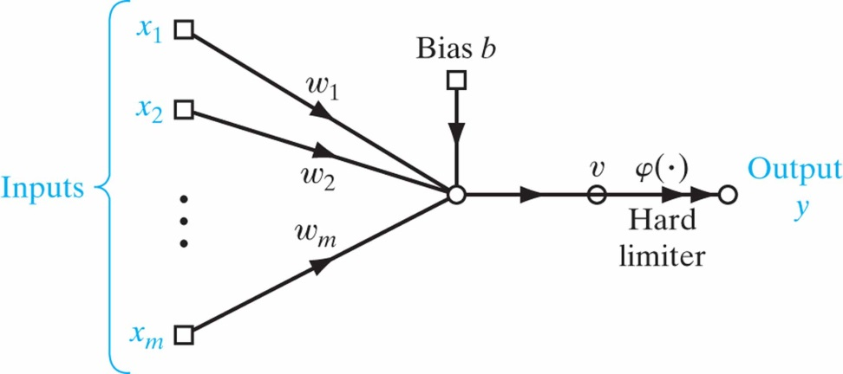
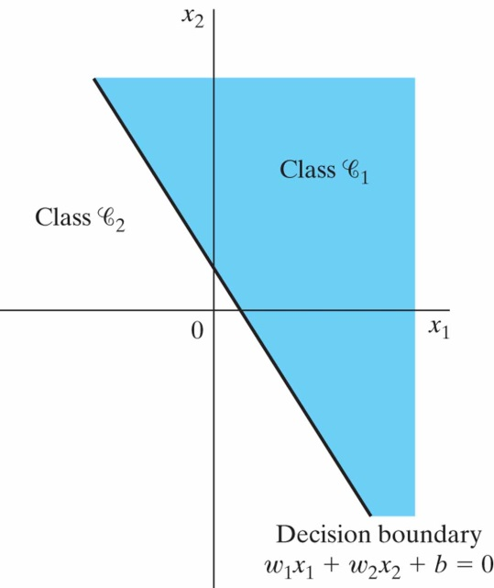
(Rosenblatt’s) Perceptron
LMS algorithm was described with a linear neuron but the perceptron is built around a non-linear neuron
Output is +1 for positive and -1 for negative (can be thought as 2 classes)
The synaptic weights can be adapted by using perceptron convergence algorithm

Slide 8
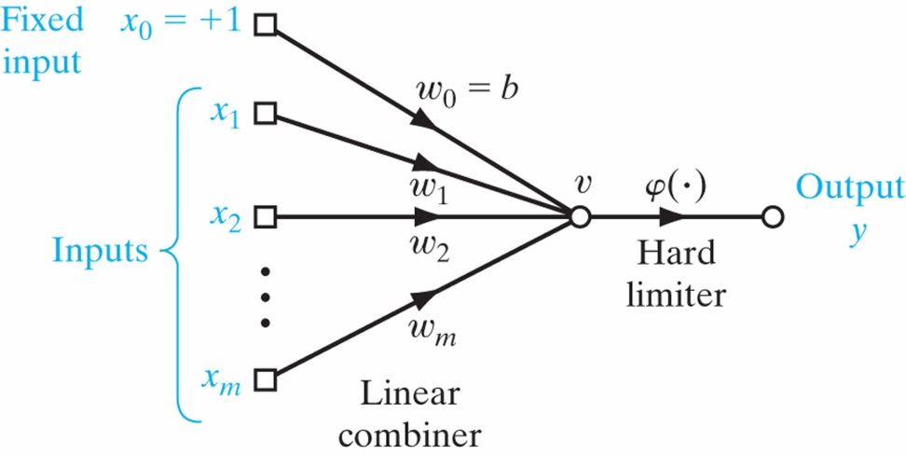
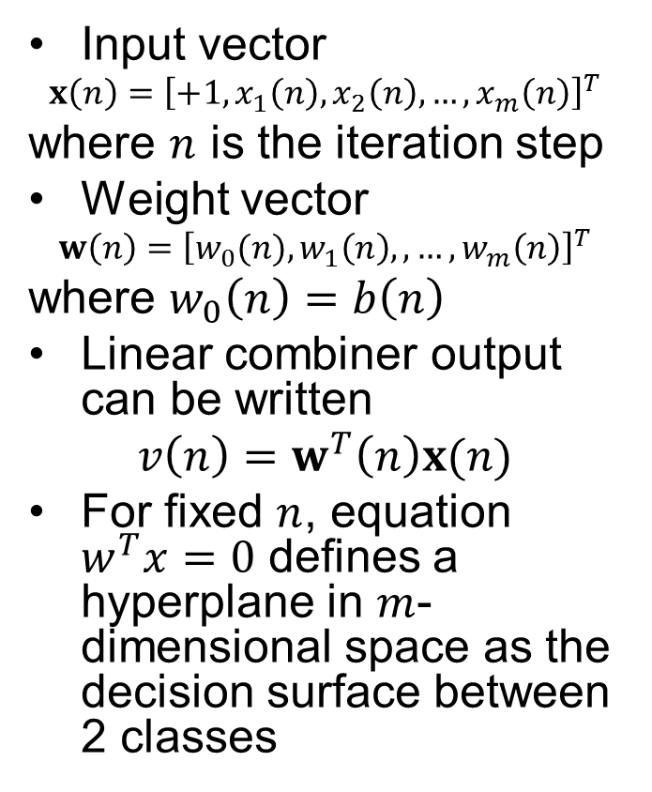
Perceptron Convergence Theorem
Input vector
$$x\left(n\right)={\left[+1,x_{1}\left(n\right),x_{2}\left(n\right),…,x_{m}\left(n\right)\right]}^{T}$$
where $n$ is the iteration step
Weight vector
$$w\left(n\right)={\left[w_{0}(n),w_{1}\left(n\right),,…,w_{m}\left(n\right)\right]}^{T}$$
where $w_{0}\left(n\right)=b\left(n\right)$
Linear combiner output can be written
$$v\left(n\right)=w^{T}\left(n\right)x(n)$$
For fixed $n$, equation $w^{T}x=0$ defines a hyperplane in $m$-dimensional space as the decision surface between 2 classes

Slide 9
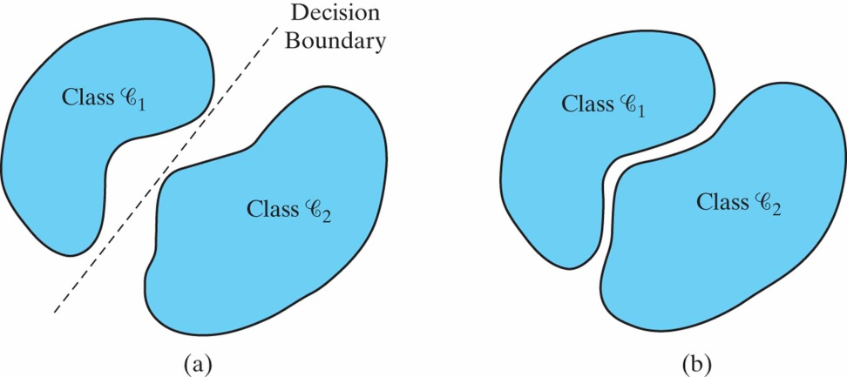
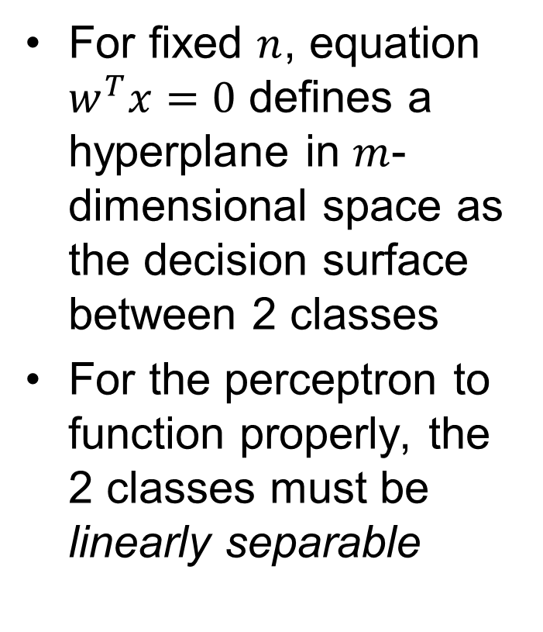
Perceptron Convergence Theorem
For fixed $n$, equation $w^{T}x=0$ defines a hyperplane in $m$-dimensional space as the decision surface between 2 classes
For the perceptron to function properly, the 2 classes must be linearly separable

Slide 10
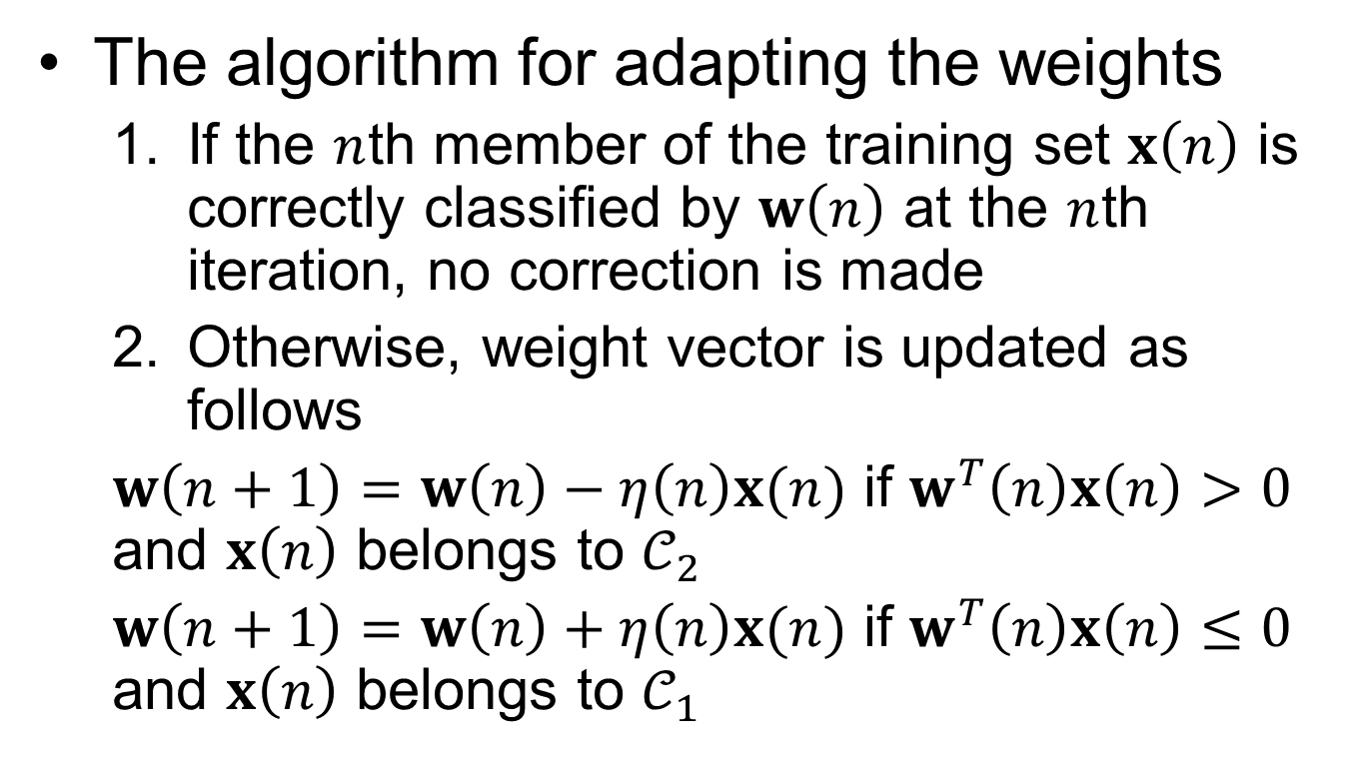
Perceptron Convergence Theorem
The algorithm for adapting the weights
If the $n$th member of the training set $x\left(n\right)$ is correctly classified by $w\left(n\right)$ at the $n$th iteration, no correction is made
Otherwise, weight vector is updated as follows
$w\left(n+1\right)=w\left(n\right)−η\left(n\right)x(n)$ if $w^{T}\left(n\right)x\left(n\right)>0$ and $x\left(n\right)$ belongs to $𝒞_{2}$
$w\left(n+1\right)=w\left(n\right)+η\left(n\right)x(n)$ if $w^{T}\left(n\right)x\left(n\right)≤0$ and $x\left(n\right)$ belongs to $𝒞_{1}$

Slide 11
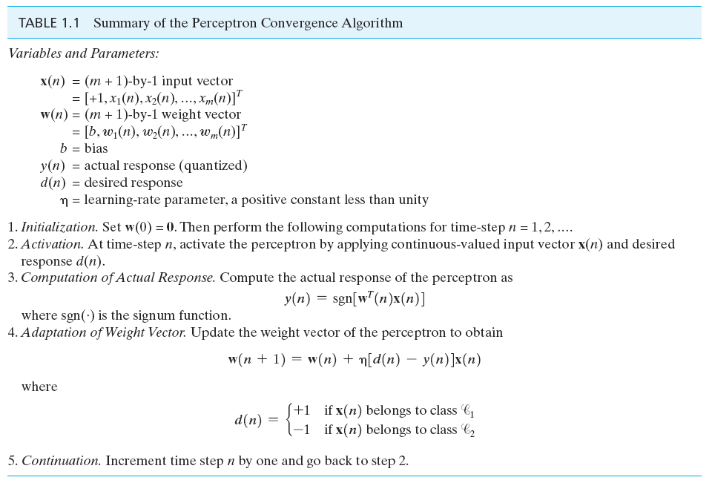
Perceptron Convergence Theorem

